Slide 1

RECOMMENDATION SYSTEM USING MATRIX FACTORISATION (SVD)
SUBMITTED BY:-
Sai Jyotirmayee Rout (190410154)
Prabhudatta Mishra(190310094)
GUIDED BY:- Dr. Biranchi Narayan Rath

Slide 2

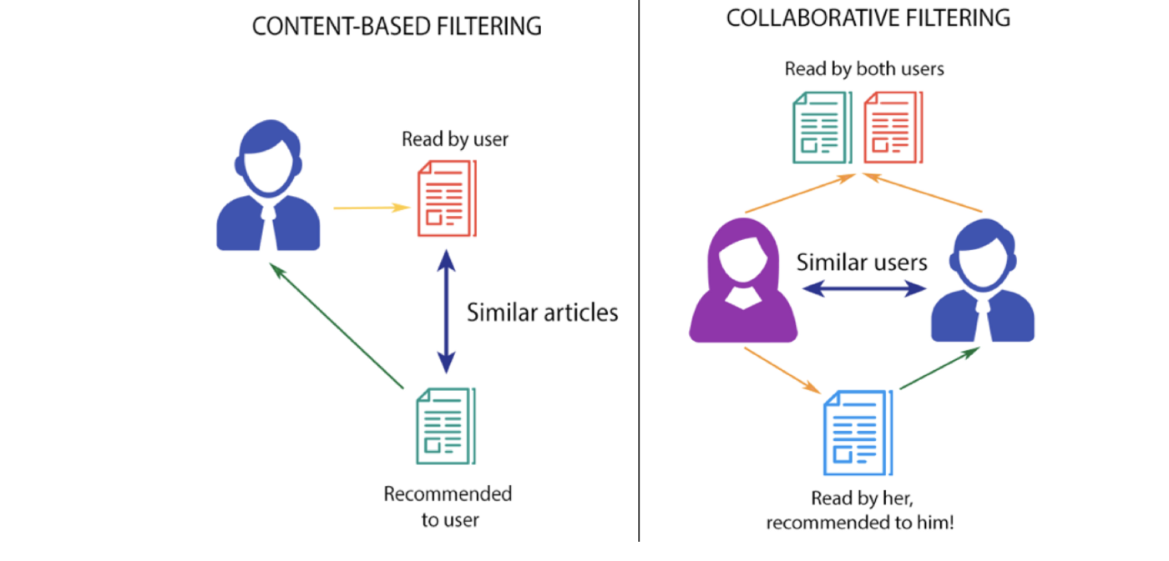
What is Recommendation system?
Recommender System is a system that seeks to predict or filter preferences according to the user’s choices. Recommender systems are utilized in a variety of areas including movies, music, news, books, research articles, search queries, social tags, and products in general.
Recommender systems produce a list of recommendations in any of the two ways :-
Collaborative filtering: It approaches build a model from the user’s past behavior (i.e. items purchased or searched by the user) as well as similar decisions made by other users.
Content-based filtering :-It approaches uses a series of discrete characteristics of an item in order to recommend additional items with similar properties.

Slide 3
What is SVD?
SVD is a fancy way to factorise/decompose a matrix into three other matrices (A = UΣVᵀ) and is used as collaborative filtering technique.
Here A is m x n utility matrix, U is a m x r orthogonal singular matrix, Σ is r x r square diagonal matrix of singular values ,Vt is r x n orthogonal singular matrix.
Data Preprocessing
(Cell 1-5):- After importing the numpy and pandas Libraries the csv files of movies and ratings are read.
(Cell 6):- Overview of both the dataframes .
(Cell 8-11):- Plotted a Cross table with userid and movieid filling it with ratings ,then coverted it to matrix.
(Cell 12-13):- Mean ratings of each particular userid .
(Cell 14-15):-Demeaned the data by subtracting the mean ratings from the original ratings .

Slide 4
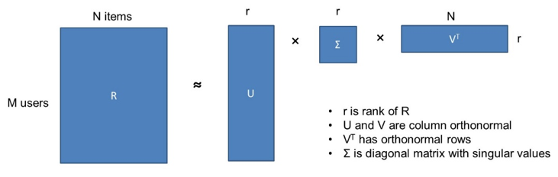
Recommendation model using SVD
Cell(16-21):- Import SVD from scipy library which decomposes the demeaned matrix into 3 singular matrices that are U , sigma and Vt.
Cell(22-25):- Determined the predicted ratings using dot product of matrices.
Cell(26-28):-defined a function that returns the movies that have been already rated by the user and the recommended movies.
Results
Cell(29-31):- RMSE is calculated with reference to the original and predicted ratings. For this model the RMSE is 0.31.The lesser the RMSE ,the more accurate the model will be.

Slide 5
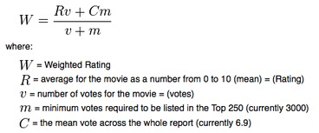
DISCUSSIONS
Recommendation Model Using Weighted Average Ratings:-
Based on the concept of rating system by IMDB ratings, this model suggests movies based on a given weighted ratings. IMDB uses a specific method to assign each movie with a weighted rating.
By sorting the data based on the weighted rating we can get our movie recommendations
Disadvantages:-
All movies aren’t rated but can be popular so we will have to prioritize the data between the popular movies and weighted ratings which may reduce the efficiency of the model. It isn’t that personalized compared to other models and just suggests basic movies based on the IMDB ratings

Slide 6
Recommendation System Using Correlation
What is correlation?
Well, in simple terms correlation establishes a relation between a dependent and an independent variable.
It gives us a brief idea on how much two features are related to each other and in which way. Maybe positively correlated or negatively correlated. After getting the clean data we created a pivot table to get info about the ratings given by various users to different movies.
After that we extracted the particular movie data and used correlation to check the relationship between various data and based on the correlation score we can recommend the movies.
Disadvantages:-
We found that at a particular period we can recommend movies based on a single movie and not a recommendation based on the stack of movies that we go through.

Slide 7
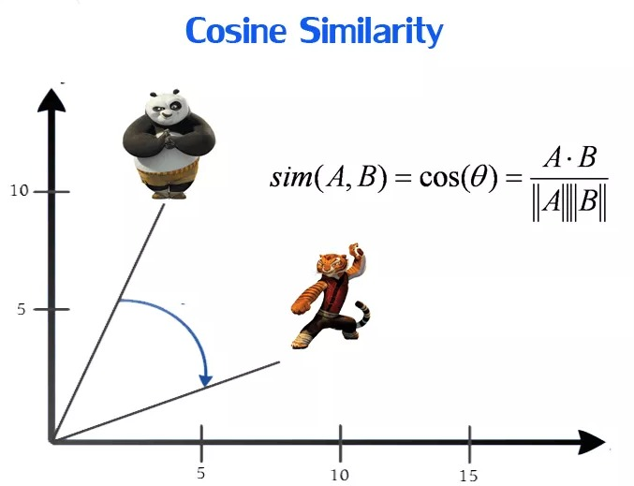
Recommendation Systems Using Cosine Similarity And KNN
Basically using the simple math tools of cosine distance and cosine similarity a recommendation system can be generated using the nearest neighbours algorithm we get the points which lies nearer and can give a highly related output.
What Is Cosine Similarity??
Disadvantage:
With large data , the prediction stage might get slow.
Accuracy is directly depended on the quality of data

Slide 8
Why Chosen SVD?
Advantages of SVD
Simplifies data, removes noise, may improve algorithm results.
Less computational complexity and robust against post processing operations.
Have low RMSE
It is very stable and efficient
Can be applied to non-square matrices.
Disadvanatages of SVD
Sometimes transformed may be difficult to understand and interpret.
Difficult to deal with image compression.

Slide 9
THANK YOU

